Slide 1



Slide 2
Helping Students
to Realize Their Dreams
for the Last 14 Years

Slide 3


Slide 4
Topic: ITO Database

Slide 5
SQL Server supports two types of installation −
Standalone
Cluster based
Checks
Check RDP access for the server.
Check OS bit, IP, domain of server.
Check if your account is in admin group to run setup.exe file.
Software location.

Slide 6
Requirements
Which version, edition, SP and hotfix if any.
Service accounts for database engine, agent, SSAS, SSIS, SSRS, if any.
Named instance name if any.
Location for binaries, system, user databases.
Authentication mode.
Collation setting.
List of features.

Slide 7
Pre-requisites for 2012&2014
Setup support files.
.net framework 4.0.
SQL Server native client.
Windows installer 4.5/later version.
Windows PowerShell 2.0.
Pre-requisites for 2005
Setup support files.
.net framework 2.0.
SQL Server native client.
Pre-requisites for 2008&2008R2
Setup support files.
.net framework 3.5 SP1.
SQL Server native client.
Windows installer 4.5/later version.

Slide 8
SQL INSTALLATION
Prerequisite :
Download the archive zipfile from given below directory. Download directory
unzip the file.
Rename it with ‘mysql’ (for ease of use of the folder in later steps).

Slide 9
SQL INSTALLATION
Step-1 :Create a new directory – Create a new directory for data in the cmd prompt. When you will use the database you need a directory, where all your files will be saved. Create a directory called “mysql-files” (you can choose any other name also) to keep all your works.
Create a new directory for data in cmd prompt by using the following steps.
"Search" button ⇒ Enter "cmd" ⇒ Click on "Command Prompt"

Slide 10
SQL INSTALLATION
STEP1:
Creating a directory in the Documents folder
cd Documents (it will enter into the folder)
C:Users\Username>cd Documents
now you can create a directory with the keyword mkdir.
mkdir mysql-files

Slide 11
SQL INSTALLATION
Step-2 :Initialize the database –
Start a CMD.
Go to the the path where after renaming as mysql is saved and then go to bin folder using keyword cd filename.
C:Users\Username>cd Documents
C:Users\Username\Documents>cd mysql
C:Users\Username\Documentsmysql>cd bin
C:Users\Username\Documents\mysql\bin>

Slide 12
SQL INSTALLATION
Execute the following command in the cmd path of bin in mysql extracted path
(i.e. in the path C:Users\Username\Documents\mysql\bin>).
mysqld –console –initialize –basedir=(path of newly created data directory)
–datadir=(path of newly created data directory)
After executing the initialize command, Temporary password will be generated. Don’t forget to note that password.

Slide 13
SQL INSTALLATION
Step-3 :Adding the directory – Execute the following command in the command prompt or in the same path as follows.
Add the newly created data which we named as “mysql-files” in Step1
mysqld --console --datadir=(path of newly created data directory)

Slide 14
SQL INSTALLATION
Step-4 :Start the server – Now open another command prompt without closing the present command prompt (in another cmd window of path bin of MySQL)
Execute the following command as follows
mysql -u root -p
As using it the first time, you need to alter the password (temporary password that you have noted in step-2)

Slide 15
SQL INSTALLATION
Step-5 :Change the password of user root –
A last step: As using it the first time, you need to alter the password (as you have used temporary password) when you open the server as follows.
ALTER USER root@localhost IDENTIFIED
BY '<Your password>';

Slide 16
SQL INSTALLATION
Now, Your mysql is ready to use. The above steps was to install and use it at first time. When using MySQL later everytime, you can follow the 3rd and 4th steps:
Execute following command as follows
mysqld –console –datadir=(path of newly created data directory)
2.(in another cmd window of path bin of mysql)
mysql -u root -p

Slide 17
SQL PLUS AND HR USER CONNECTION
Connecting to Oracle Database as User HR
Topics:
Unlocking the HR Account
Connecting to Oracle Database as User HR from SQL*Plus
Connecting to Oracle Database as User HR from SQL Developer

Slide 18
SQL PLUS AND HR USER CONNECTION
Access the menu from which you can select SQL Developer:
On a Windows system: From the Start menu, select All Programs.
On a Linux system:
On Gnome: Click Application.
On KDE: Click K.
Select Oracle - ORACLE_HOME.
Select Application Development.
Select SQL Developer.
If this is the first time you have started SQL Developer on your system,
you are prompted to enter the full path to java.exe (for example, C:\jdk1.5.0\bin\java.exe).
Either type the full path after the prompt or browse to it, and then press the key Enter.
The Oracle SQL Developer window opens.

Slide 19
SQL PLUS AND HR USER CONNECTION
5.In the navigation frame of the window, click Connections.
The Connections pane appears.
6.In the Connections pane, click the icon New Connection.
The New/Select Database Connection window opens.

Slide 20
SQL PLUS AND HR USER CONNECTION
7. In the New/Select Database Connection window, type the appropriate values in the fields Connection Name, Username, and Password.
For Connection Name, enter hr_conn.
(You can enter a different name, but the tutorials in this document assume that you named the connection hr_conn.)
For Username, enter HR.
For Password, enter the password for the HR account.
8.In the New/Select Database Connection window, click the tab Oracle.
The Oracle pane appears.

Slide 21
SQL PLUS AND HR USER CONNECTION
9.In the Oracle pane:
For Role, accept the default.
For Connection Type, accept the default (Basic).
In the fields Hostname and Port, type the appropriate values.
Select the option SID.
In the SID field, type the appropriate value.
At step 9:
For Role, accept the default.
For Connection Type, accept the default (Basic).
For Hostname, enter localhost
For SID, enter orc1
For Port, enter 1521

Slide 22
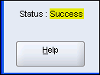
SQL PLUS AND HR USER CONNECTION
10. In the New/Select Database Connection window, click the button Test.
The connection is tested. If the connection succeeds, the Status indicator changes from blank to success

Slide 23
SQL PLUS AND HR USER CONNECTION
11. If the test succeeded, click the button Connect.
The New/Select Database Connection window closes. The Connections pane shows the connection whose name you entered in the Connection Name field in step 7.
You are in the SQL Developer environment.
To exit SQL Developer, select Exit from the File menu.

Slide 24
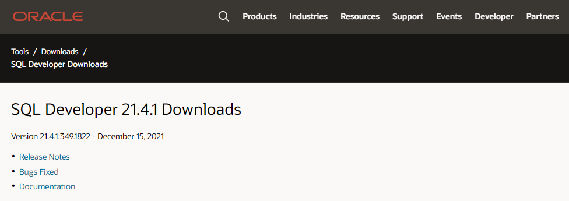
CONNECT WITH SQL DEVELOPER
Installing SQL Developer on Windows:
Follow the below steps to install SQL Developer on Windows:
Step 1:

Slide 25
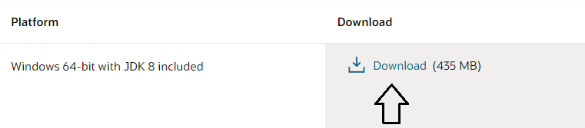
CONNECT WITH SQL DEVELOPER
Step 2: Click on download.

Slide 26
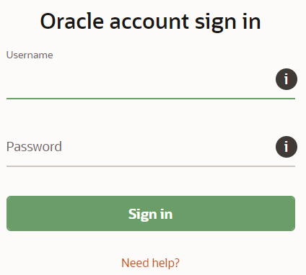
CONNECT WITH SQL DEVELOPER
Step 3: Login in Oracle account or create a new account.

Slide 27
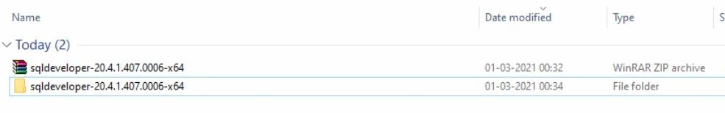
CONNECT WITH SQL DEVELOPER
Step 4: Extract the downloaded zip file.

Slide 28
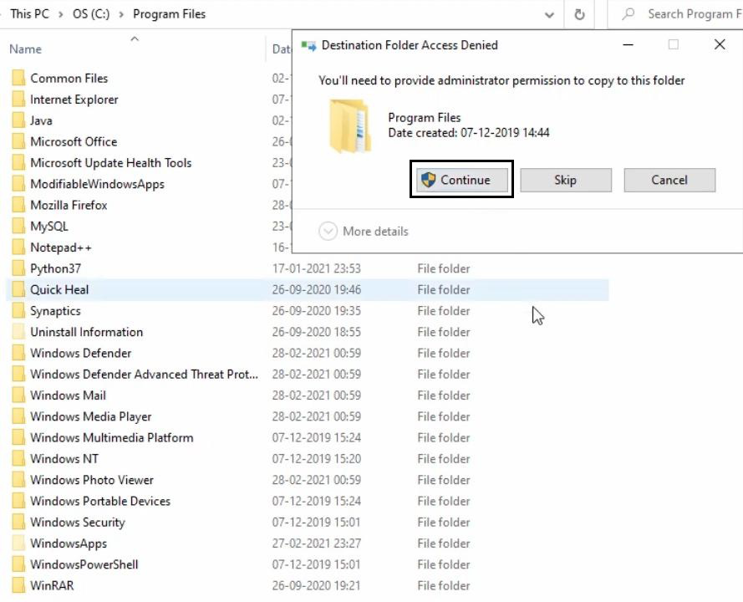
CONNECT WITH SQL DEVELOPER
Step 5: Open your computer C drive & program files. Cut & Paste the extracted file there.

Slide 29
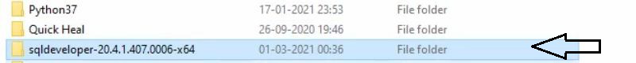
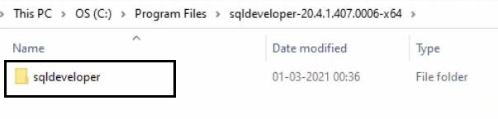
CONNECT WITH SQL DEVELOPER
Step 6: Open the folder.
Step 7: Then open sqldeveloper folder.

Slide 30
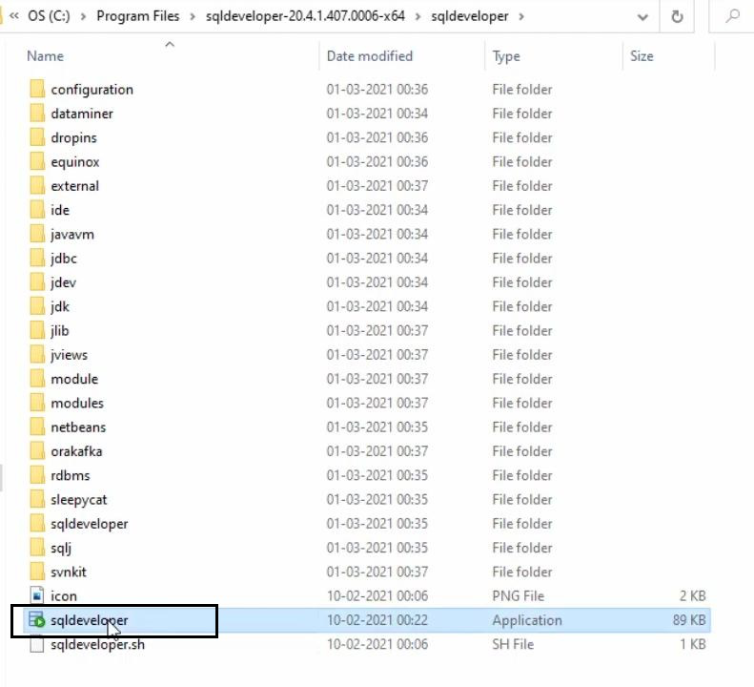
CONNECT WITH SQL DEVELOPER
Step 8: Find the sqldeveloper exe file there. Create a shortcut on desktop.

Slide 31
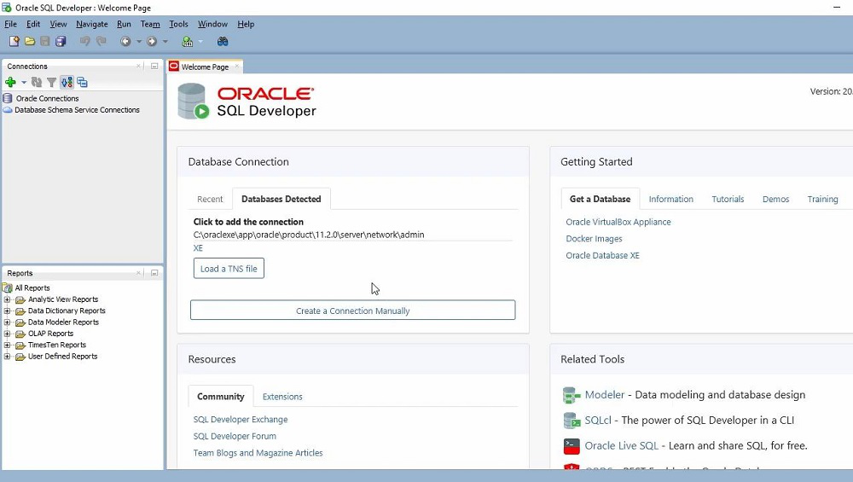
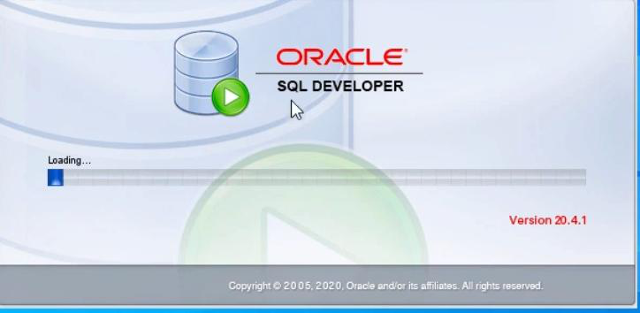
CONNECT WITH SQL DEVELOPER
Step 9: Open the shortcut.

Slide 32
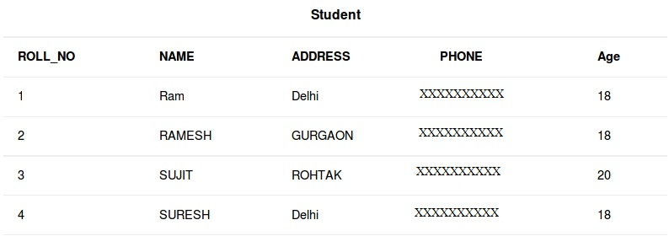
RETRIVE DATA USING SQL SELECT ELEMENT
Select is the most commonly used statement in SQL.
The SELECT Statement in SQL is used to retrieve or fetch data from a database.
Sample Table:

Slide 33
RETRIVE DATA USING SQL SELECT ELEMENT
Basic Syntax:
SELECT column1,column2 FROM table_name
column1 , column2: names of the fields of the table
table_name: from where we want to fetch
To fetch the entire table or all the fields in the table:
SELECT * FROM table_name;
Query to fetch the fields ROLL_NO, NAME, AGE from the table Student
SELECT ROLL_NO, NAME, AGE FROM Student;

Slide 34
RETRIVE DATA USING SQL SELECT ELEMENT
Output:
OLL_NO | NAME | Age
1 | Ram | 18
2 | RAMESH | 18
3 | SUJIT | 20
4 | SURESH | 18

Slide 35
RETRIVE DATA USING SQL SELECT ELEMENT
To fetch all the fields from the table Student:
SELECT * FROM Student;
Output:
ROLL_NO | NAME | ADDRESS | PHONE | Age
1 | Ram | Delhi | XXXXXXXXXX | 18
2 | RAMESH | GURGAON | XXXXXXXXXX | 18
3 | SUJIT | ROHTAK | XXXXXXXXXX | 20
4 | SURESH | Delhi | XXXXXXXXXX | 18

Slide 36
SORTING DATA
Ways of sorting in Java
Using loops
Using sort() method of Arrays class
Using sort method of Collections class
Sorting on a subarray

Slide 37
SORTING DATA
Way 1: Using loops
EXAMPLE:
Sorting using loops

Slide 38
SORTING DATA
Way 2: Using sort() method of Arrays class
Example 1
Using sort()

Slide 39
SORTING DATA
Way 3: Using sort() method of Collections class
Collections.sort() works for objects Collections like ArrayList and LinkedList.
Example
Collection class

Slide 40
SORTING DATA
Way 4: Sorting only a subarray
EXAMPLE:
Subarray

Slide 41
FUNCTIONS IN SQL
Single row function:
Single row functions are those functions which return a single result row for each row of queried table or view. This functions exists in Select lists, WHERE clause, START WITH, CONNECT BY clause and HAVING clause.
Numeric_functions
Character_function
Data_mining_function
Datetime_functions
Conversion_function
Collection_function
XML_function

Slide 42
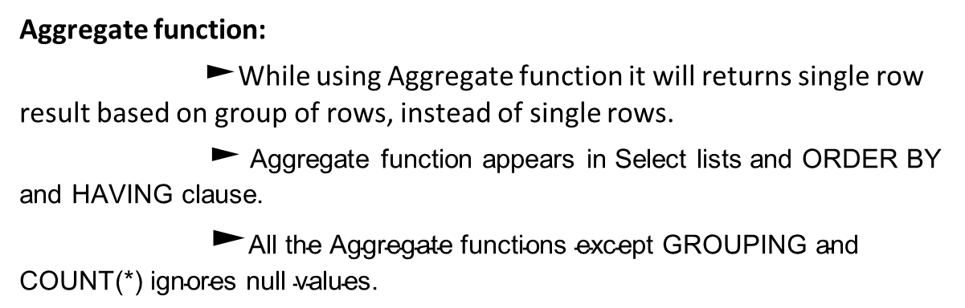
FUNCTIONS IN SQL
Aggregate function: $►$While using Aggregate function it will returns single row result based on group of rows, instead of single rows.
$►$ Aggregate function appears in Select lists and ORDER BY and HAVING clause.
$►\text{All} \text{the} \text{Aggregate} \text{functions} \text{except} \text{GROUPING} \text{and} \text{COUNT}\text{(∗) }\text{ignores} \text{null} \text{values}\text{.}$

Slide 43
FUNCTIONS IN SQL
EXAMPLE:
SELECT AVG(MAX(salary)
FROM employees
GROUP BY department_id
AVG(MAX(salary))
----------------
10925
Most frequently used Aggregate functions
AVG, COUNT, DENSE_RANK, MAX, MIN, RANK, SUM.

Slide 44
DISPLAY DATA FROM MULTIPLE TABLES
Table 1:
Table 2:
Table 3:
ID | FirstName
1 | Nisha
2 | Manoj
3 | Pooja
ID | LastName
1 | Gupta
2 | Desai
3 | Kumari
GID | PID | Asset
1 | P1 | Laptop
2 | P2 | Desktop
3 | P3 | Laptop
4 | P4 | None

Slide 45
DISPLAY DATA FROM MULTIPLE TABLES
Example to select from multiple tables :
SELECT Geeks3.GID, Geeks3.PID,
Geeks3.Asset, Geeks1.FirstName,
Geeks2.LastName
FROM Geeks3
LEFT JOIN Geeks1
ON Geeks3.GID = Geeks1.ID
LEFT JOIN Geeks2
ON Geeks3.GID = Geeks2.ID
GID | PID | Asset | FirstName | LastName
1 | P1 | Laptop | Nisha | Gupta
2 | P2 | Desktop | Manoj | Desai
3 | P3 | Laptop | Pooja | Kumari
4 | P4 | None | NULL | NULL
Output :

